Slide 1


AI HEALTHCARE
HUB
ALL IN ONE SOLUTIONS FOR ALL HEALTH ISSUES
Submitted by:
Created under the guidance of:
Saurav Mukherjee 10800120011
Dipak Kumar Kewat 10800120017
Rammohan Choudhary 10800120052
Manvi Bishnu 10800120058
Dr. Abhishek Bandyopadhyay
(Head of Department, AI/ML)

Slide 2

AI HEALTHCARE HUB
ASANSOL ENGINEERING COLLEGE
Table of Contents
Introduction........................................................................ Pg 3
Flow Diagram..................................................................... Pg 4
Landing Page..................................................................... Pg 5
Sign up to become a Donor.................................... Pg 6
Needy? Get free heathcare services................. Pg 7
AI-based diagnosis and prediction................... Pg 10
Mental health and wellness..................................... Pg 14
Future work.......................................................................... Pg 16
Conclusion........................................................................... Pg 17
Visit us..................................................................................... Pg 18

Slide 3

AI HEALTHCARE HUB
INTRODUCTION
AI Healthcare Hub pioneers a revolutionary approach at the crossroads of healthcare and artificial intelligence. This innovative project employs advanced technologies like machine learning and blockchain to redefine healthcare, transcending conventional disease management. With predictive disease algorithms, mental wellness resources, community engagement features, and a unique healthcare donation platform, It envisions a holistic well-being experience. Emphasizing ethics, user-centric design, and continual improvement.
It aims to empower individuals globally, transcending geographic and socioeconomic boundaries. This initiative signifies a transformative fusion of technology and compassionate care, fostering a future where individuals proactively manage their health for a more fulfilling life.

Slide 4
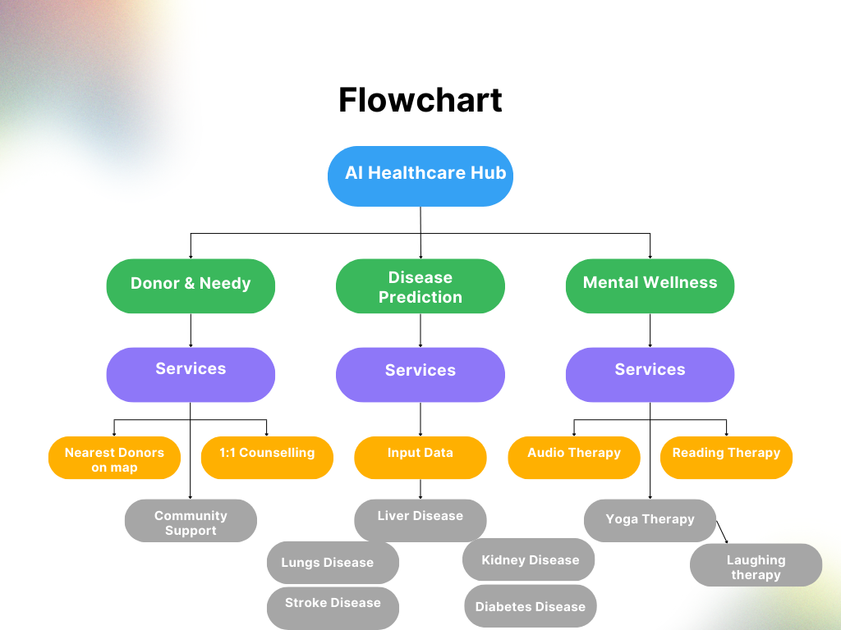
AI HEALTHCARE HUB

Slide 5
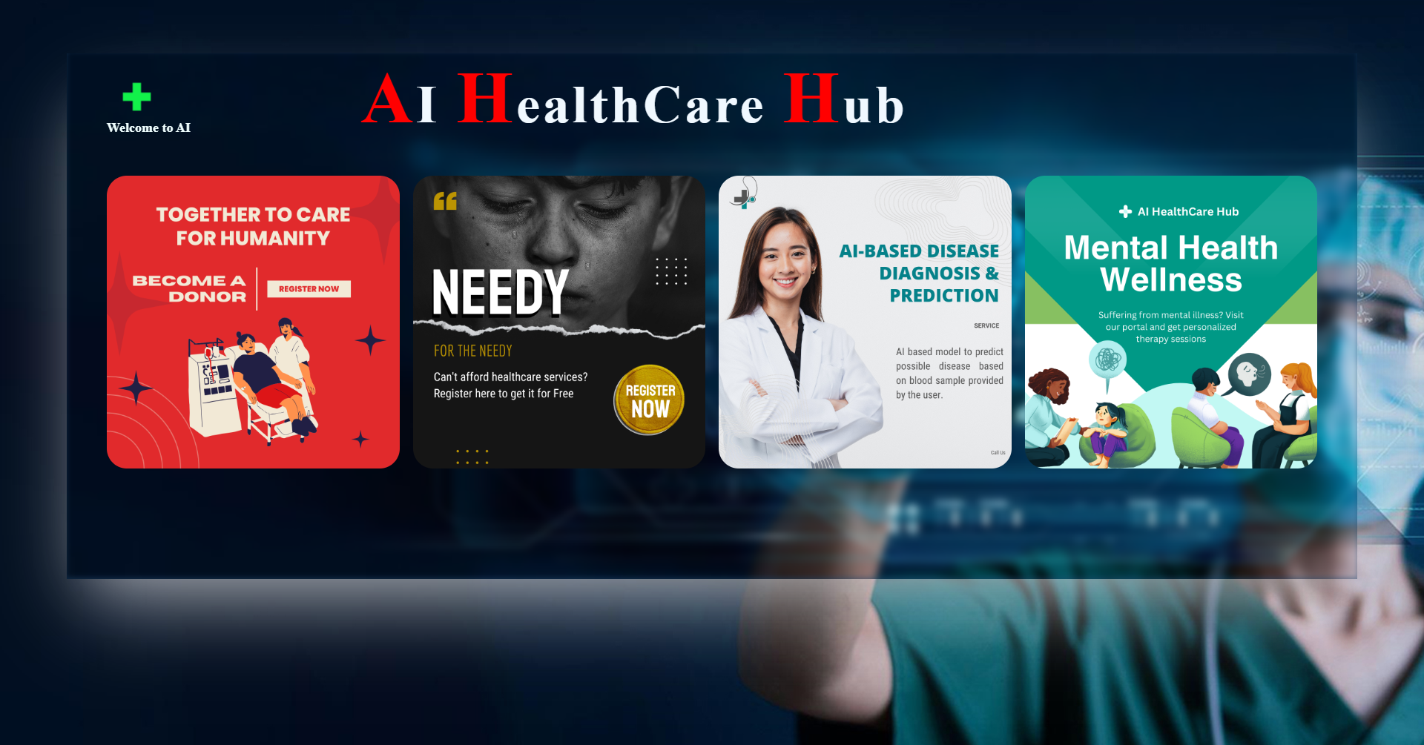
Landing Page
ASANSOL ENGINEERING COLLEGE
AI HEALTHCARE HUB
Primary Care
Specialty Care
Presentations are communication tools that can use as lectures, speeches, reports, and more.
Presentations are communication tools that can use as lectures, speeches, reports, and more.

Slide 6

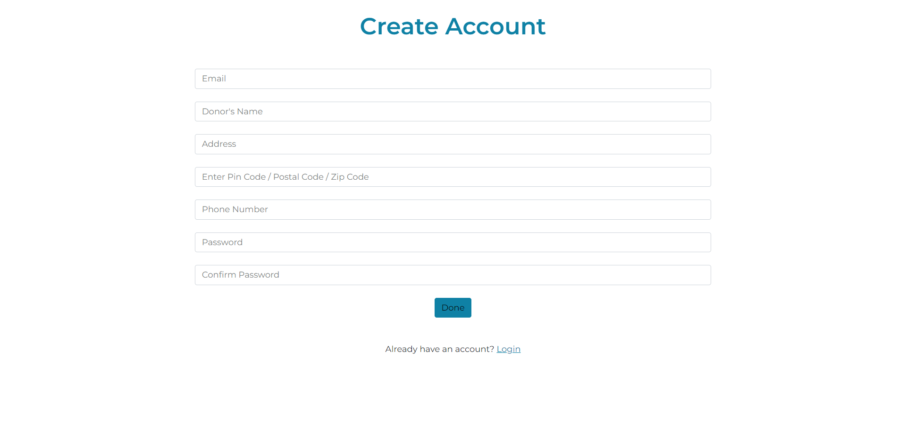
Become A Donor Today!

Slide 7
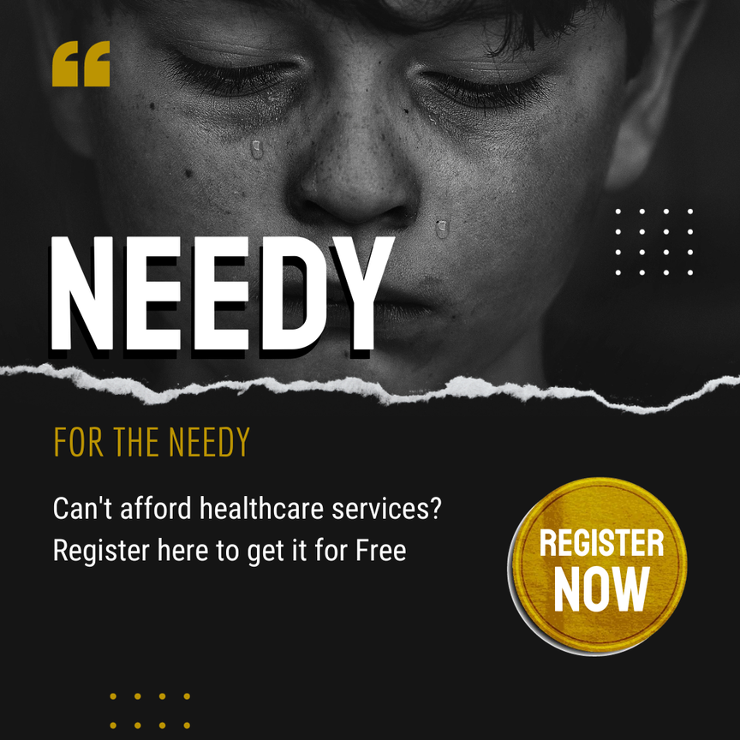
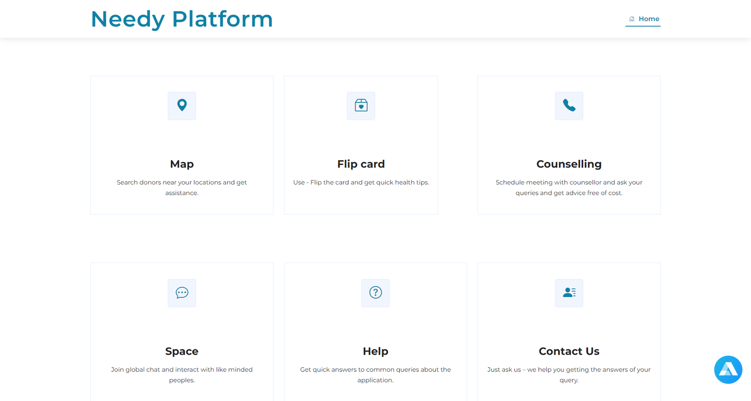
AI HEALTHCARE HUB
ASANSOL ENGINEERING COLLEGE
Needy Portal

Slide 8
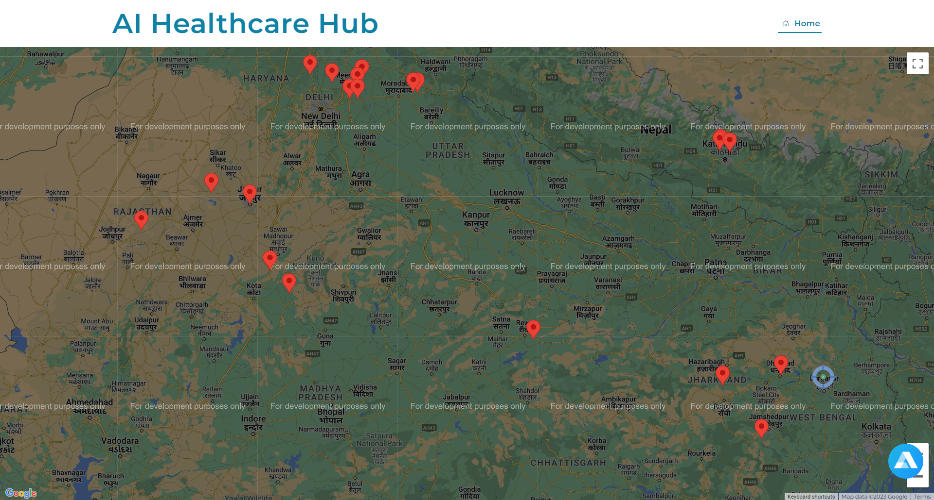
Map
AI HEALTHCARE HUB
ASANSOL ENGINEERING COLLEGE

Slide 9
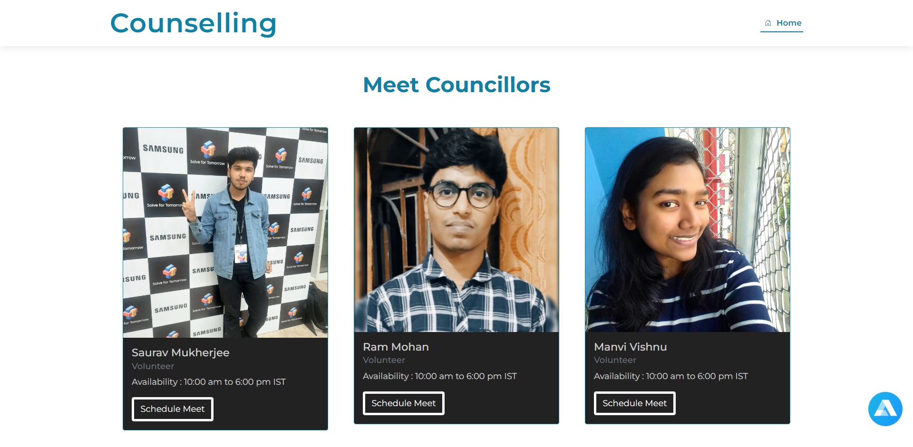
AI HEALTHCARE HUB
ASANSOL ENGINEERING COLLEGE

Slide 10
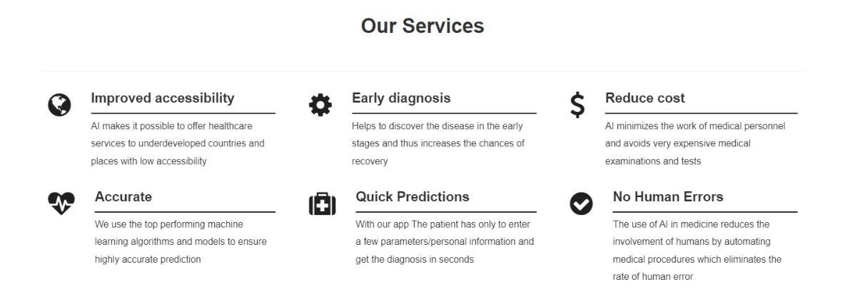
AI based disease diagnosis and prediction
AI HEALTHCARE HUB

Slide 11
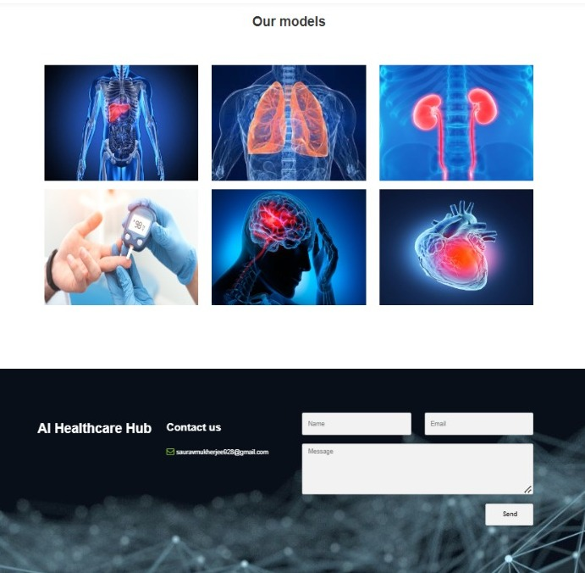
AI HEALTHCARE HUB
Get a diagnosis and
prediction based on your reports
ASANSOL ENGINEERING COLLEGE
Our Models

Slide 12
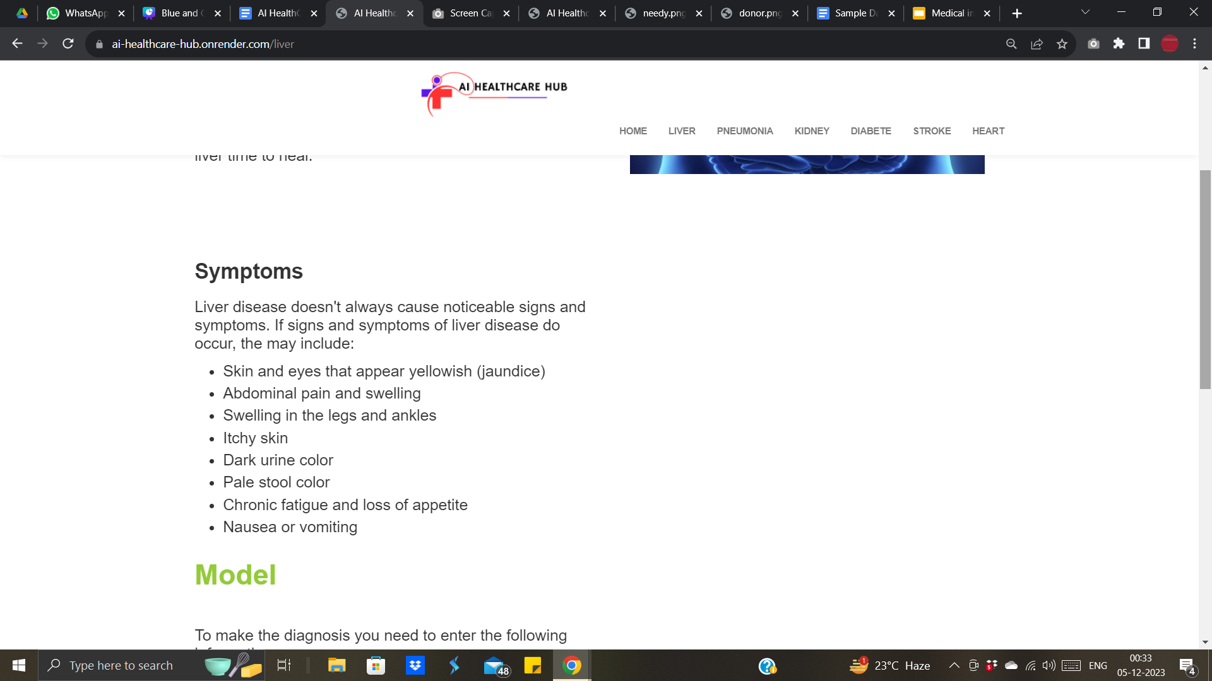
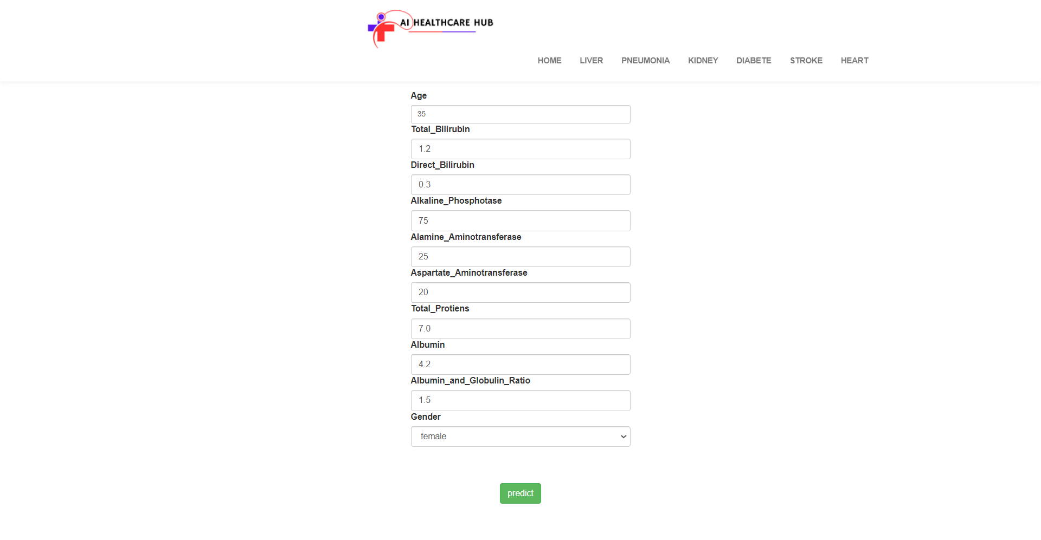

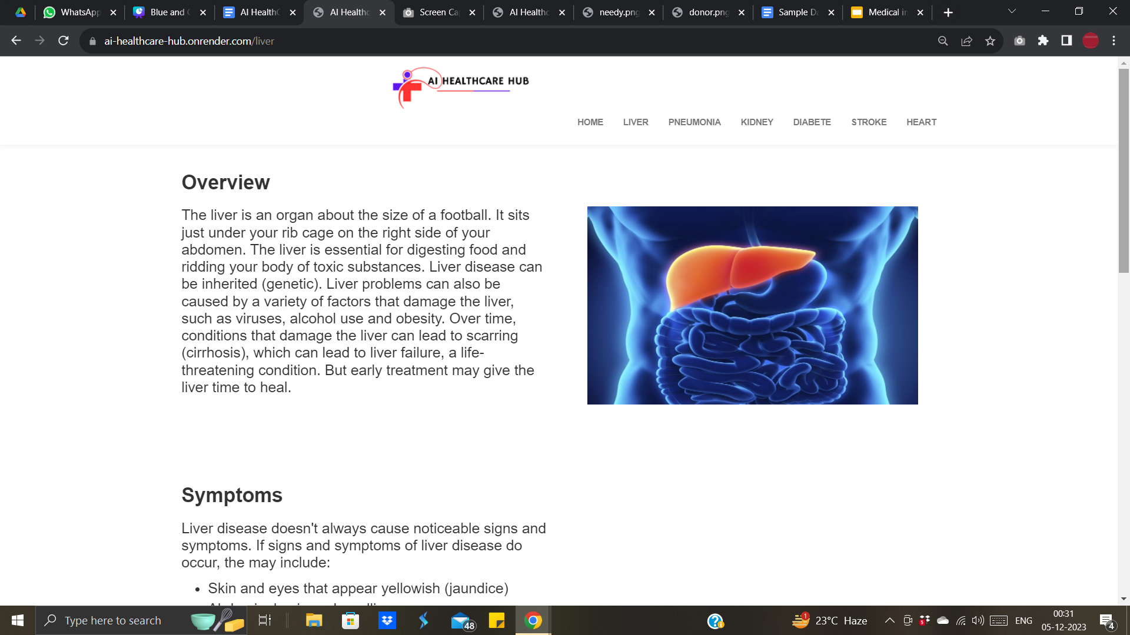
How it works
ASANSOL ENGINEERING COLLEGE
AI HEALTHCARE HUB

Slide 13
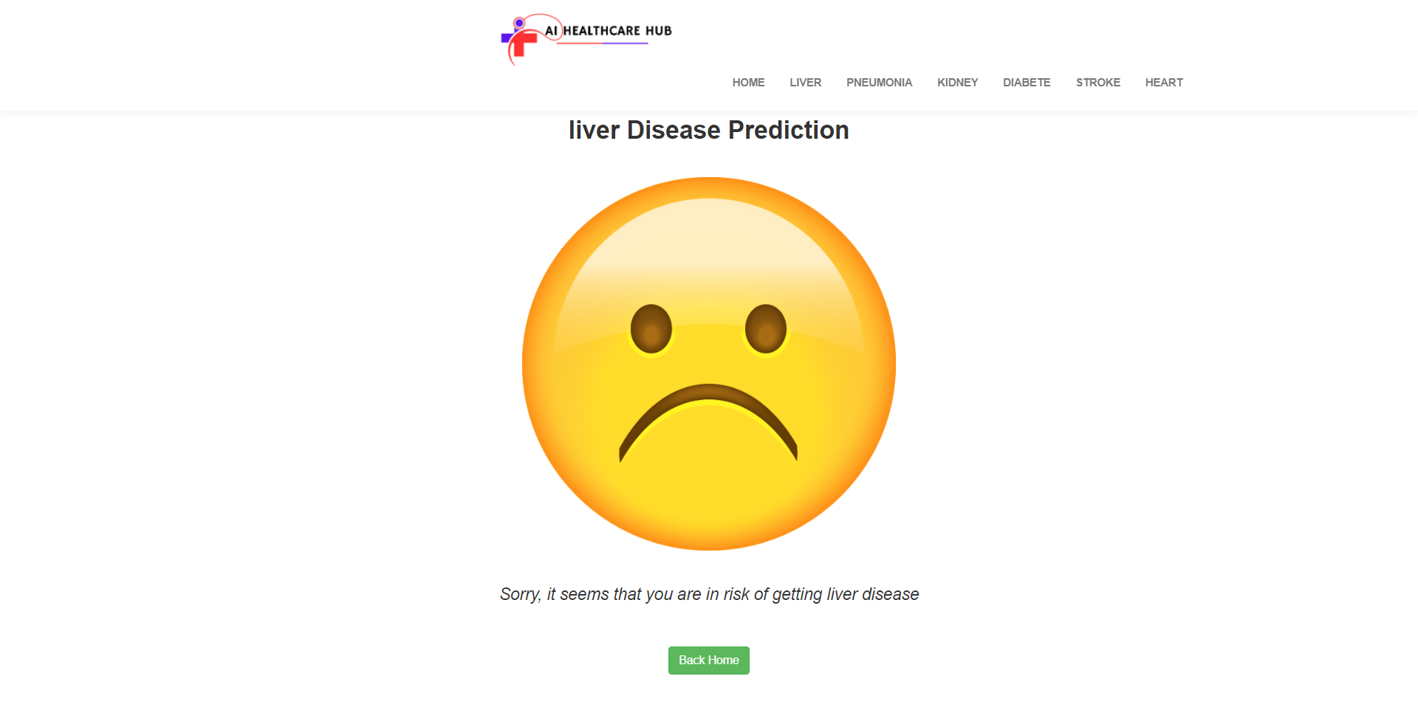
AI HEALTHCARE HUB
Resultant Prediction
ASANSOL ENGINEERING COLLEGE

Slide 14
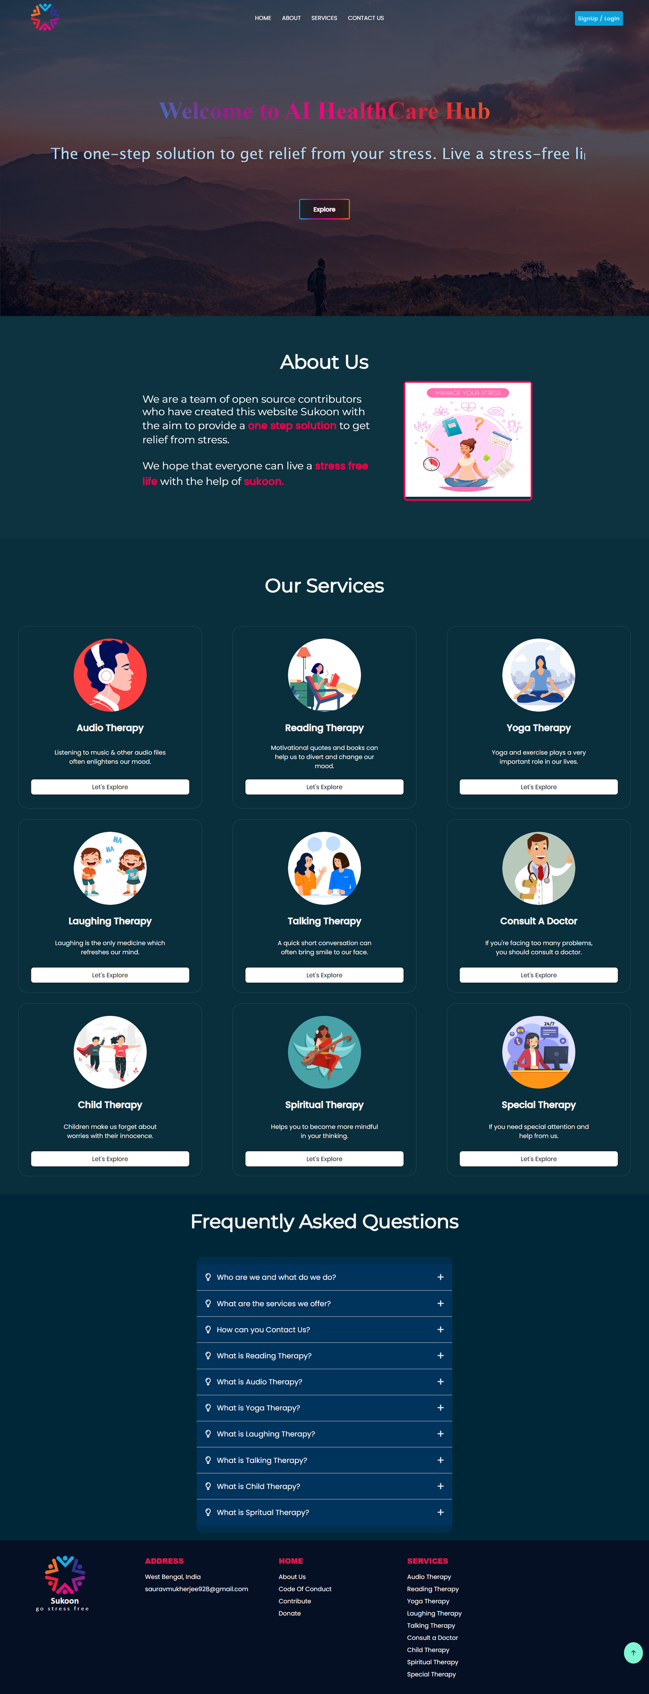


Mental Wellness
AI HEALTHCARE HUB
ASANSOL ENGINEERING COLLEGE

Slide 15

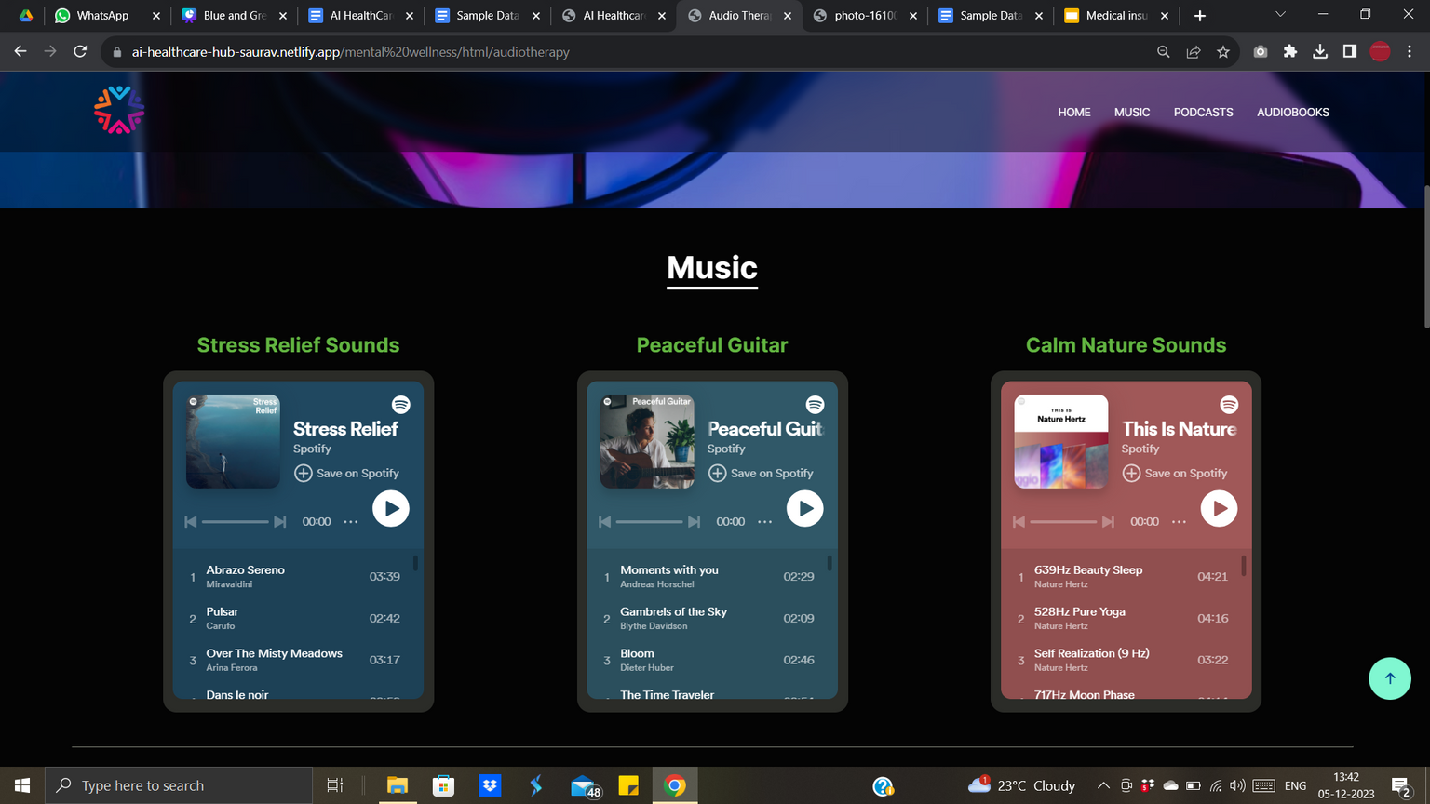
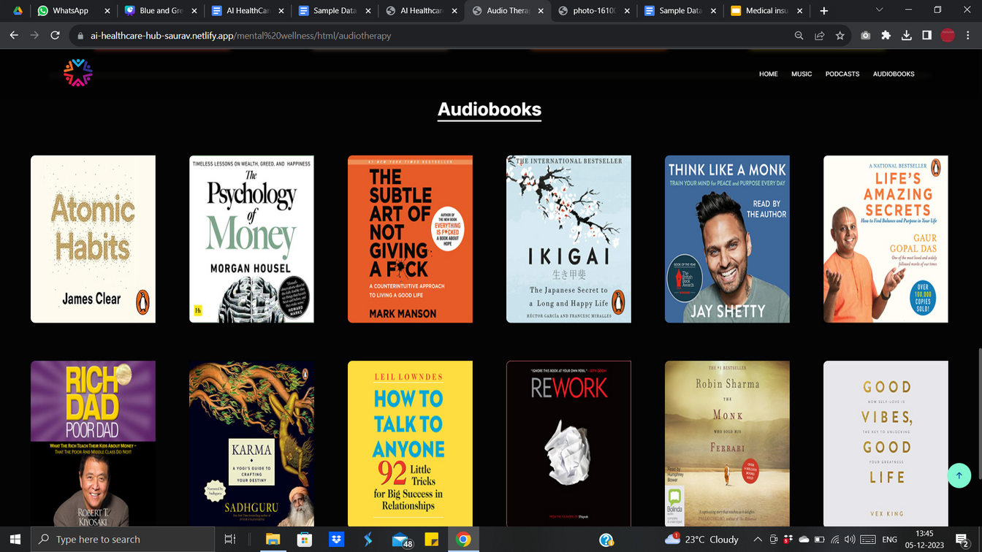
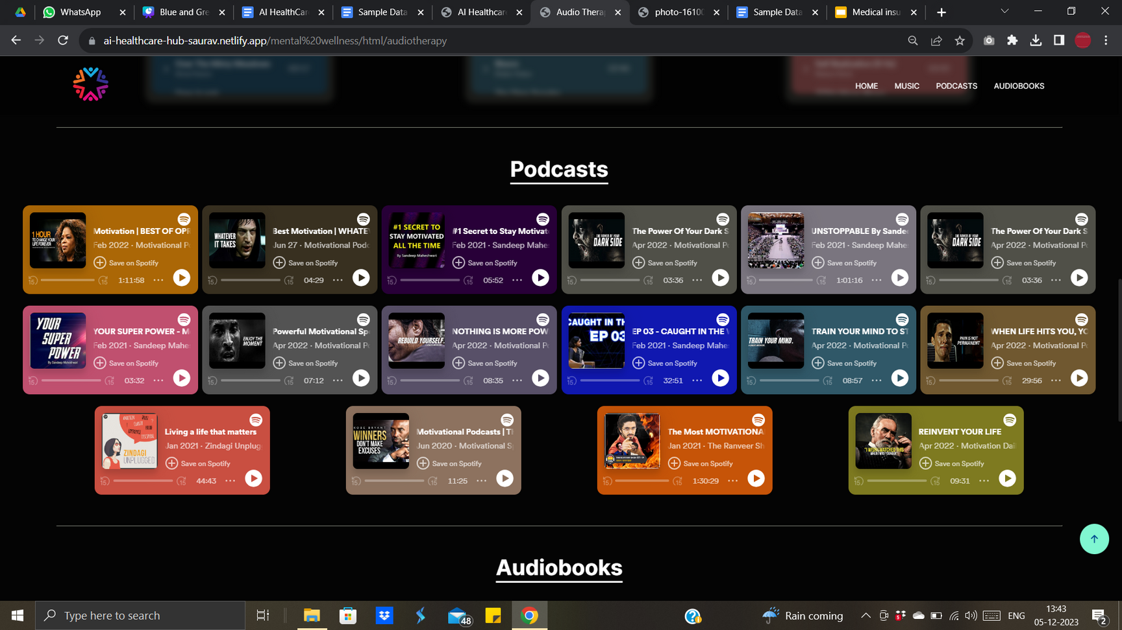
Eg: Audio Therapy
AI HEALTHCARE HUB
ASANSOL ENGINEERING COLLEGE

Slide 16

ASANSOL ENGINEERING COLLEGE
Future Work
Real-Time Monitoring:
Implement real-time health data monitoring with edge computing.
Genetic Integration:
Collaborate for genomic data inclusion, providing personalized health insights.
Global Expansion:
Tailor the platform for global reach and diverse healthcare needs.
Continuous Model Improvement:
Regularly update disease prediction models based on evolving medical research.
Innovations in Telemedicine:
Explore AI-driven diagnostics and advanced telemedicine features.
Privacy-Centric Wearables:
Strengthen wearable integration with a focus on user privacy.
AI-Driven Drug Discovery:
Investigate AI applications in drug discovery for personalized medication.

Slide 17
AI HEALTHCARE HUB
ASANSOL ENGINEERING COLLEGE
CONCLUSION
In conclusion, AI Healthcare Hub marks a pioneering stride toward a holistic healthcare future, seamlessly blending cutting-edge technology with compassionate well-being. Through predictive disease algorithms, mental wellness resources, and a unique donation platform, it aspires to empower users globally. Anchored in ethics, user-centric design, and a commitment to continual enhancement, Al Healthcare Hub envisions a world where healthcare transcends boundaries. This transformative initiative encapsulates a vision of proactive health management, fostering a fulfilling and healthier life for individuals. AI Healthcare Hub stands as a testament to the potent synergy of innovation and care in reshaping the landscape of healthcare.

Slide 18

AI HEALTHCARE HUB
ASANSOL ENGINEERING COLLEGE
Visit us:
AI Healthcare Hub pioneers a revolutionary approach at the crossroads of healthcare and artificial intelligence. This innovative project employs advanced technologies like machine learning to redefine healthcare, transcending conventional disease management.
Get Application Here
www.ai-healthcare-hub-saurav.netlify.app

